Slide 1

Why are magnets useful?
“A man who is certain he is right is almost sure to be wrong.”
― Michael Faraday

Slide 2

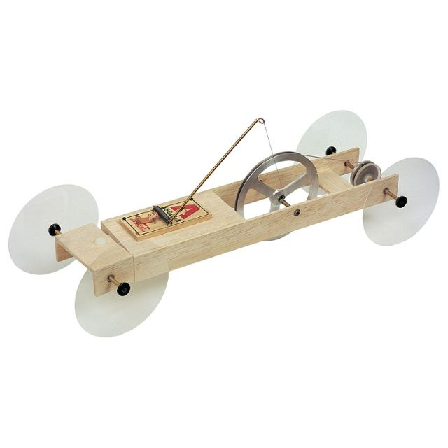
Project description
Source
The ECE department are developing STEM projects for year 8 to year 10 High School students.
They want to excite and encourage students who haven’t gained an interest in engineering yet.
They are looking for the electrical equivalent of the mousetrap car.

Slide 3
What is a STEM Project?
Science
Technology
Engineering
Mathematics

Slide 4
Expectations and Requirements
Looking for the electrical equivalent of the mouse trap car.
have less than 90 minutes to complete the project.
1 tutor per group.
Cost limit of $500.
No voltages above 20 V (DV or RMS AC).
Easy to change components if needed.
Schematics and drawing’s will be provided as well as a user guide for the tutor.

Slide 5
Project Overview
What
Why
How

Slide 6
Why are magnets useful?
“A man who is certain he is right is almost sure to be wrong.”
― Michael Faraday

Slide 7
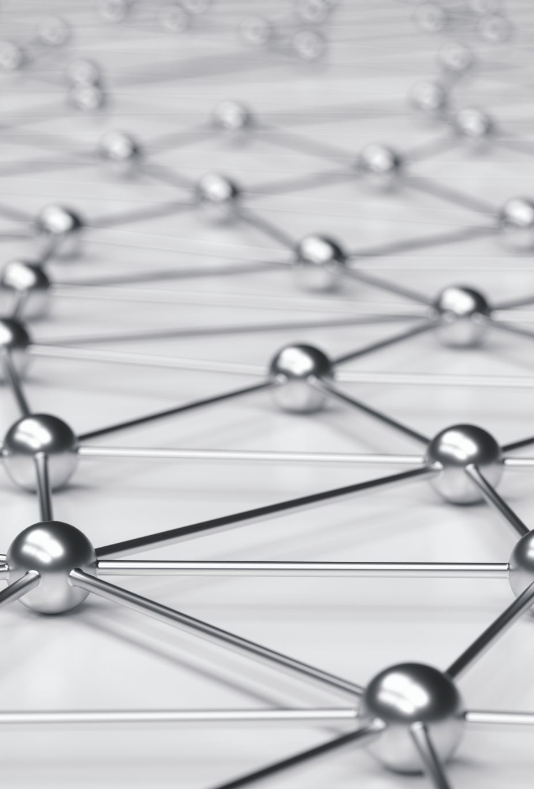
What will they learn?
Principles of Magnetism and Electromagnetism.
What it is and how it works.
Perform experiments with magnets.
How electromagnetic induction works.
How this is used in the real world.

Slide 8

Why should they learn this?
To determine whether Electric current can be created without using a battery?
If we can, this would mean a reduction in the world’s global chemical consumption.
Chemical plants are extremely dangerous!

Slide 9

Extremely dangerous
Explosion in Chenjiagang industrial park occurred
March 25th, 2019

Slide 10
How will they learn this?
They will conduct 3 experiments.
Experiment I – Making a Compass
Main objective is to learn about magnets.
Experiment II – Faraday’s experiment modified
Main objective is to learn about electromagnetic induction.
Experiment III – Faraday’s flashlight
Practical use case.

Slide 11
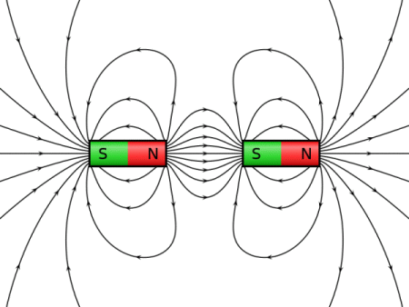
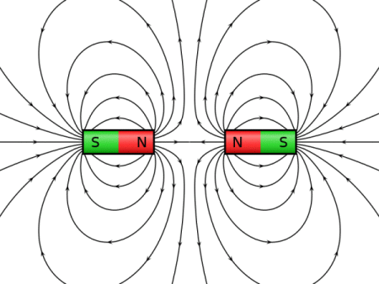
Experiment I – Making a Compass
To identify what a magnetic field is and how they interact with nearby magnets.
Understand what magnetism is.
Like poles repel.
Unlike poles attract.
Magnets

Slide 12
Experiment I – Making a Compass
To determine and mark the direction of the magnets North pole (useful later).
[Pic of prototype]
Magnets

Slide 13
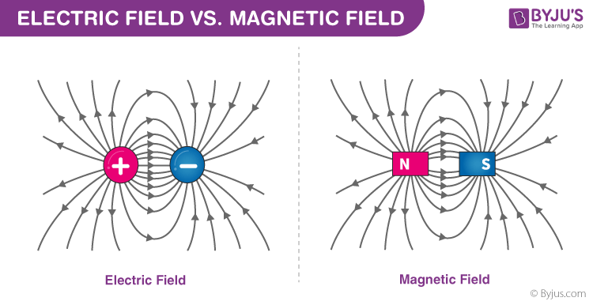
Experiment II - Faraday’s Experiment (modified)
To identify what a electric field is and how one can be created.
To know the difference between a electric field and a magnetic field.
To identify what a Electromagnet is.
Electromagnetic induction
Notes:
An electric field is essentially a force field that's created around an electrically charged particle.
Electromagnet = a magnetic field is created when electric current is induced in a wire.

Slide 14
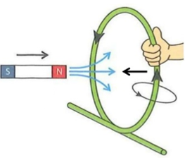
Experiment II - Faraday’s Experiment (modified)
Understand that changing magnetic fields induces a current through a coil. (magnet induces magnetic fields)
Knowing the pole direction, we can use the Right hand curl rule to show how the current will flow. Thumb = magnetic field, Fingers = direction of current
Use Farady’s and Lenz’s law to determine the direction of the induced current through a coil.
Electromagnetic induction
Notes:
Emf (the voltage generated) = is the rate of change of flux around a coil

Slide 15
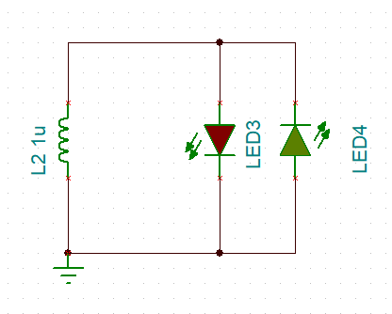

Experiment II - Faraday’s Experiment (modified)
Use Farady’s and Lenz’s law to calculate the Emf (voltage generated).
$$V_{g}=−N∙\frac{B∙A}{∆t}$$
Electromagnetic induction
Notes:
Emf (the voltage generated) = is the rate of change of flux around a coil

Slide 16
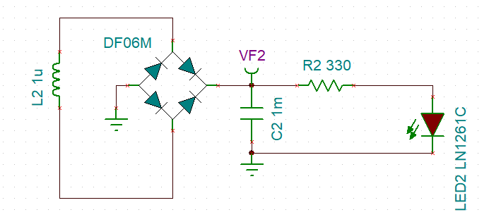

Experiment III - Faraday’s flashlight
Converts AC – DC and stores charge in a 1 Farad capacitor.
Takes … s to charge and Led stays on for $\sim$5 minutes.
Practical Scenario
Notes:
Uses same principles as before…

Slide 17
Summary
Answer the question to as why magnets are useful

Slide 18
Thanks for listening Any Questions?

Slide 19
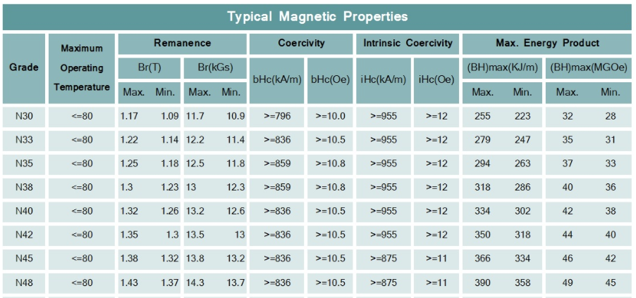
Experiment II - Faraday’s Experiment (modified)
Extra
[Pic and schematic of prototype]
Electromagnetic induction
Notes:
Emf (the voltage generated) = is the rate of change of flux around a coil

Slide 20
Extra I

Slide 21
Extra II

